Slide 1


Microclimate Weather Station Array
Technical Deep Dive Presentation
Matthew Diehl, Anthony Testa, Hemel Debnath, Bilal Mahmood
Date: 4/22/2024
Notes:
Anthony

Slide 2
Problem Statement
Climate change affects local weather and ecosystems, impacting our daily lives and resources. Understanding microclimates LOCALLY can helps us predict local climate variations, guide decisions in agriculture, and urban planning.
GOAL: Build affordable, efficient weather monitoring system that collects data on microclimates in NYS for NYSDEC
Notes:
Anthony
Climate change is a big problem; Its impacts are seen in every part of the world; One of the places it may affect is microclimates in NY; data on climate change in microclimates is critical to help NYSDEC understand
The effects climate change has on our world;
To fix this issue, a weather monitoring system that collects + shares data on microclimates to NYSDEC has to be made

Slide 3

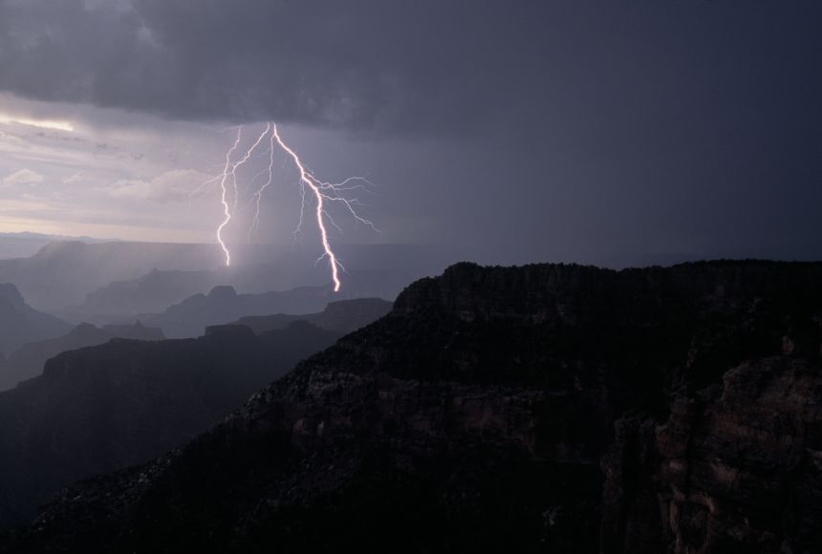

Introduction & Agenda
Our subsystem: Data Acquisition Unit
Collects temperature, precipitation, humidity data
Data can be sent to NYSDEC
Notes:
We worked on Data Acquisition Piece. It collects temperature + humidity data and precipitation data from a temp/humidity and precipitation sensor, respectively.
This data is stored in an Excel file and can be sent immediately to NYSDEC for analysis

Slide 4
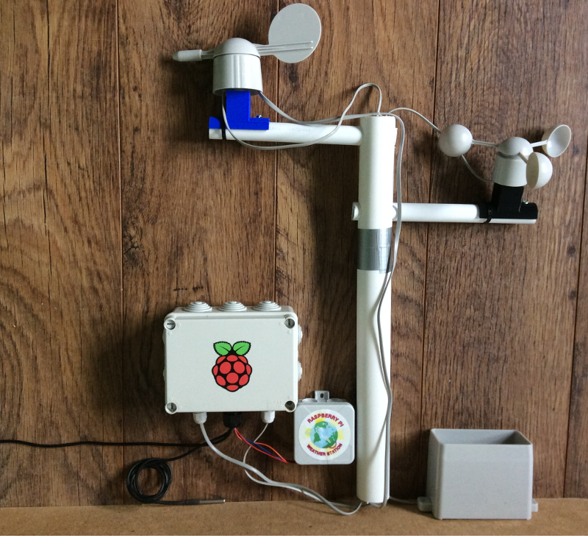
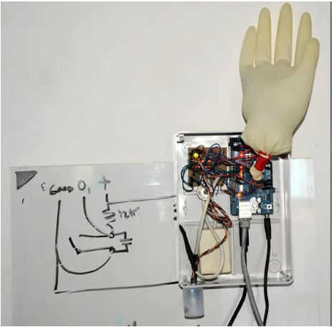
Background/Inspiration
Raspberry Pi “Build Your Own Weather System”
Uses accessible materials with many sensors, BUT is not durable
“How I Made a Fully Functional Arduino Weather Station”
Weather monitoring where data is accessed remotely over SD card
Limits: system resets after accessing data and electronics are exposed
Notes:
Prior work done on the weather system, what it does, and what they could’ve done better
First source: Tells how to build weather station using raspberry pi and sensors to collect wind speed/direction, air quality, temp, humidity sensor; Problem: It's not durable and won't withstand elements
Second source: Remote weather station; You can access its data remotely over SD card with added software to keep station running; Very hands off, but also not durable (exposed to the elements) and added software to keep station running resets station

Slide 5
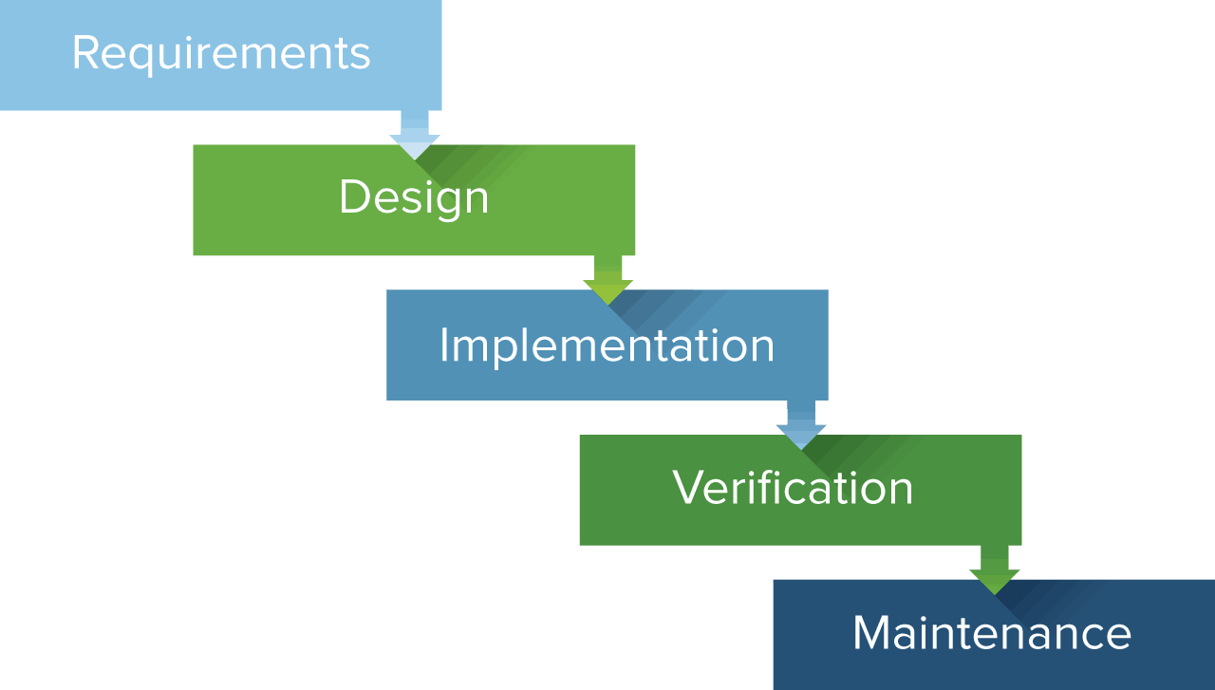
Methodology
Waterfall Methodology (fixed approach, finished subsystem step by step)
Emphasis on affordability and scalability in industry
Project Management Tool: GitHub (coordinate code, documentation, data)
Notes:
We used Waterfall Methodology; Moved from One step to the next; Mostly spent time on documentation and planning and only got to implementation once design was finalized
Main focus we had was minimizing costs and making the system with durable, easy to use materials so it could scale well.

Slide 6
Key System Requirements
Functional
Accuracy of Data: Data collected must be within 5 – 10% error difference from temperature data collected by a local weather station.
Power consumption: System must not consume more than 0.2mA when in low power mode.
Non-Functional
Durability: System must be weatherproof and function in most weather conditions.
Data conversion: System must convert data to a XLSM file.

Slide 7

Logical Design
Design Concept: The overall design was to be a durable, hands-off system that collects data and send it to the researchers. It will be inexpensive and deployed in large quantities to provide a high-resolution data set of the environment it's in.
Components: we have an array of sensors to measure weather data and a central processing unit

Slide 8
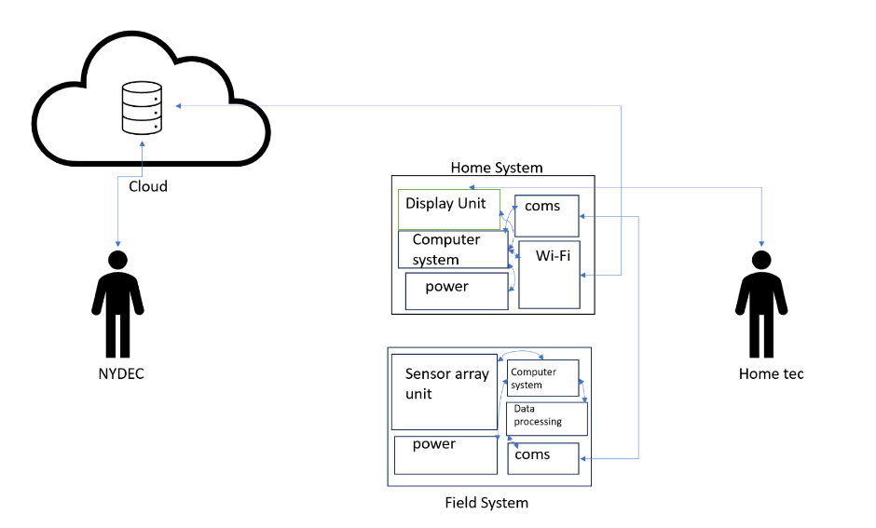

Slide 9
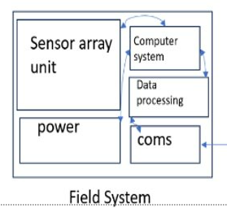
Logical Design Diagram

Slide 10
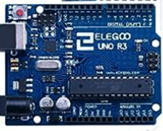

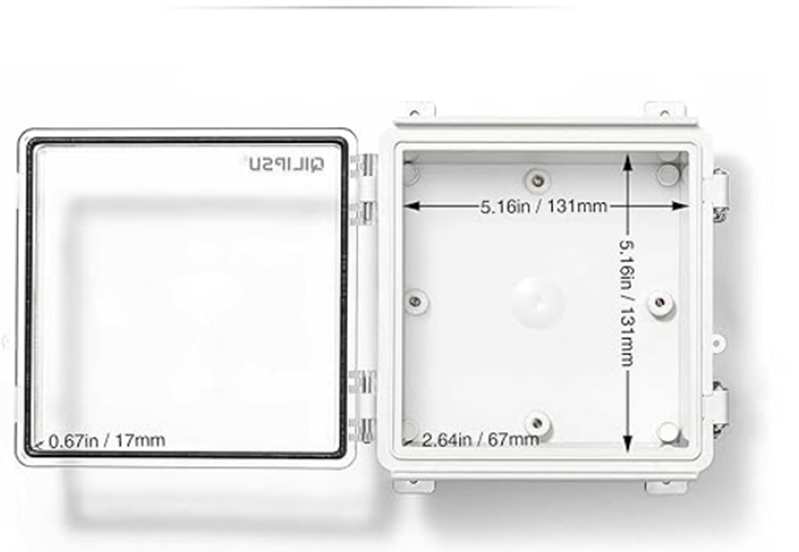

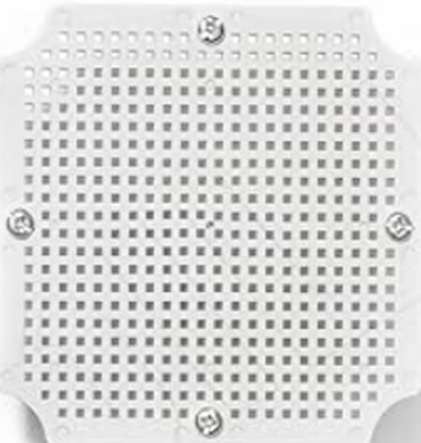

Physical Design
System Components:
Processing Unit: Sensors: Housing:

Slide 11
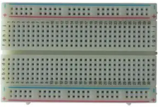

Slide 12
Physical Design
Alternatives: ESP32-C3, MSP430
Our choice for processing unit has more power consumption than our other options but is far superior in terms of library documentation, peripheral compatibility and onboard functionality.
The Uno R3 also has a low power mode that we used to lower the overall power consumption of the board, turning off components while not in use.

Slide 13
System Demonstration
We will now provide a Live Demo of our System

Slide 14
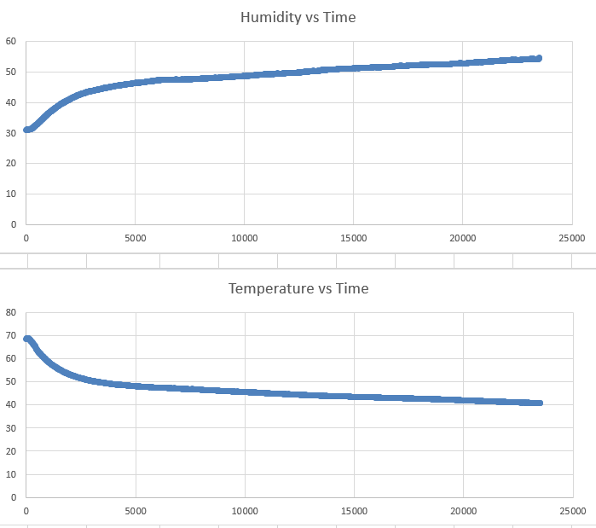
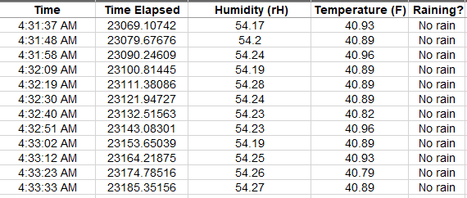
Data and Results
The system was left outside to record weather data over a long period of time, this data was then imported to excel.
Notes:
The subsystem finds info within one specific area; local and national weather is collected over an area; this could explain

Slide 15
Analysis and Discussion
The results from our test line up with accurate weather data from the internet
Sensors take some time to "ramp up" into the correct value as can be seen from the temperature and humidity plots
Eventually the reading is completely accurate and allows for recording accurate data while also being low-cost, low-energy and completely portable

Slide 16
Limitations
Doesn’t store data on its own
High Power Consumption for Arduino
Use of alternative methodologies (Agile)
Measure limited amount of data
Notes:
Wind Sensors use a lot of power and is high cost so we couldn’t include it
It sends the data off immediately to another subsystem
If the class wasn’t structured to be more planning oriented, we would be starting on working the project from the beginning

Slide 17
Recommendations for Future Work
Use an alternative microcontroller
Better mounting system for precipitation sensor
Implement more sensors to widen collected data
Prolonged Data Storage
Measure more types of data

Slide 18
Any Questions?
ANY QUESTIONS?

